Slide 1
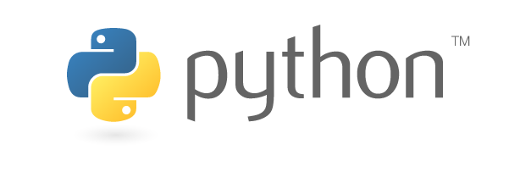

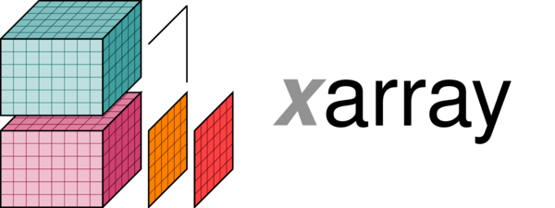
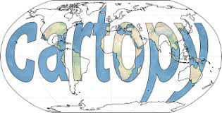
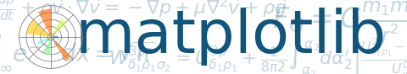

The Jupyter notebook: a tool for shareable, reproducible workflow in (atmospheric) science
Brian E. J. Rose
University at Albany (SUNY)
Tools of the Trade, AMS Student Conference
January 7, 2018

Slide 2
Outline
The need for reproducible scientific workflows
What is the Jupyter notebook?
Creation of a simple notebook
Data analysis and reproducible animation in the notebook
Installation and deployment

Slide 3
How reproducible is your workflow?
Download some data
Calculate something
Make a graph, save the image file
Iterate with new data, bug fixes, etc
Share your exciting graph!
(write paper, give talk, vaguely describe how you made the graph)
Can other people repeat your calculation and get the same result?

Slide 4
A typical (bad) scientific workflow
Download some data, save it to disk somewhere
Use your favorite interactive tool to make some plots of the data
Write a script to:
access data on your disk
do some interesting calculation on it
make an exciting graph
Save the graph to disk
Repeat on new data / after debugging, make even more exciting graph
Give a talk / write a paper featuring your exciting graph (and vaguely describing how you made it)

Slide 5
A typical (bad) scientific workflow
REPRODUCIBILITY IS FUNDAMENTAL TO THE SCIENTIFIC PROCESS
Download some data, save it to disk somewhere
Use your favorite interactive tool to make some plots of the data
Write a script to:
access data on your disk
do some interesting calculation on it
make an exciting graph
Save the graph to disk
Repeat on new data / after debugging, make even more exciting graph
Give a talk / write a paper featuring your exciting graph (and vaguely describing how you made it)
Can anyone else find and read the same data?
Great for exploratory work, but difficult to reproduce / update
Which script / which dataset produced which graph?
How to keep track?
Potential for confusion / mistakes growing rapidly…
Can other people repeat your calculation and get the same result?

Slide 6
The Jupyter notebook
Write and execute Python code in a web browser (other languages too!)
Keep graphics and other output with the code that produced them
Mix code cells with rich text, equations, etc. for a fully self-documenting workflow
Execute the notebook locally or on a remote “JupyterHub” server

Slide 7
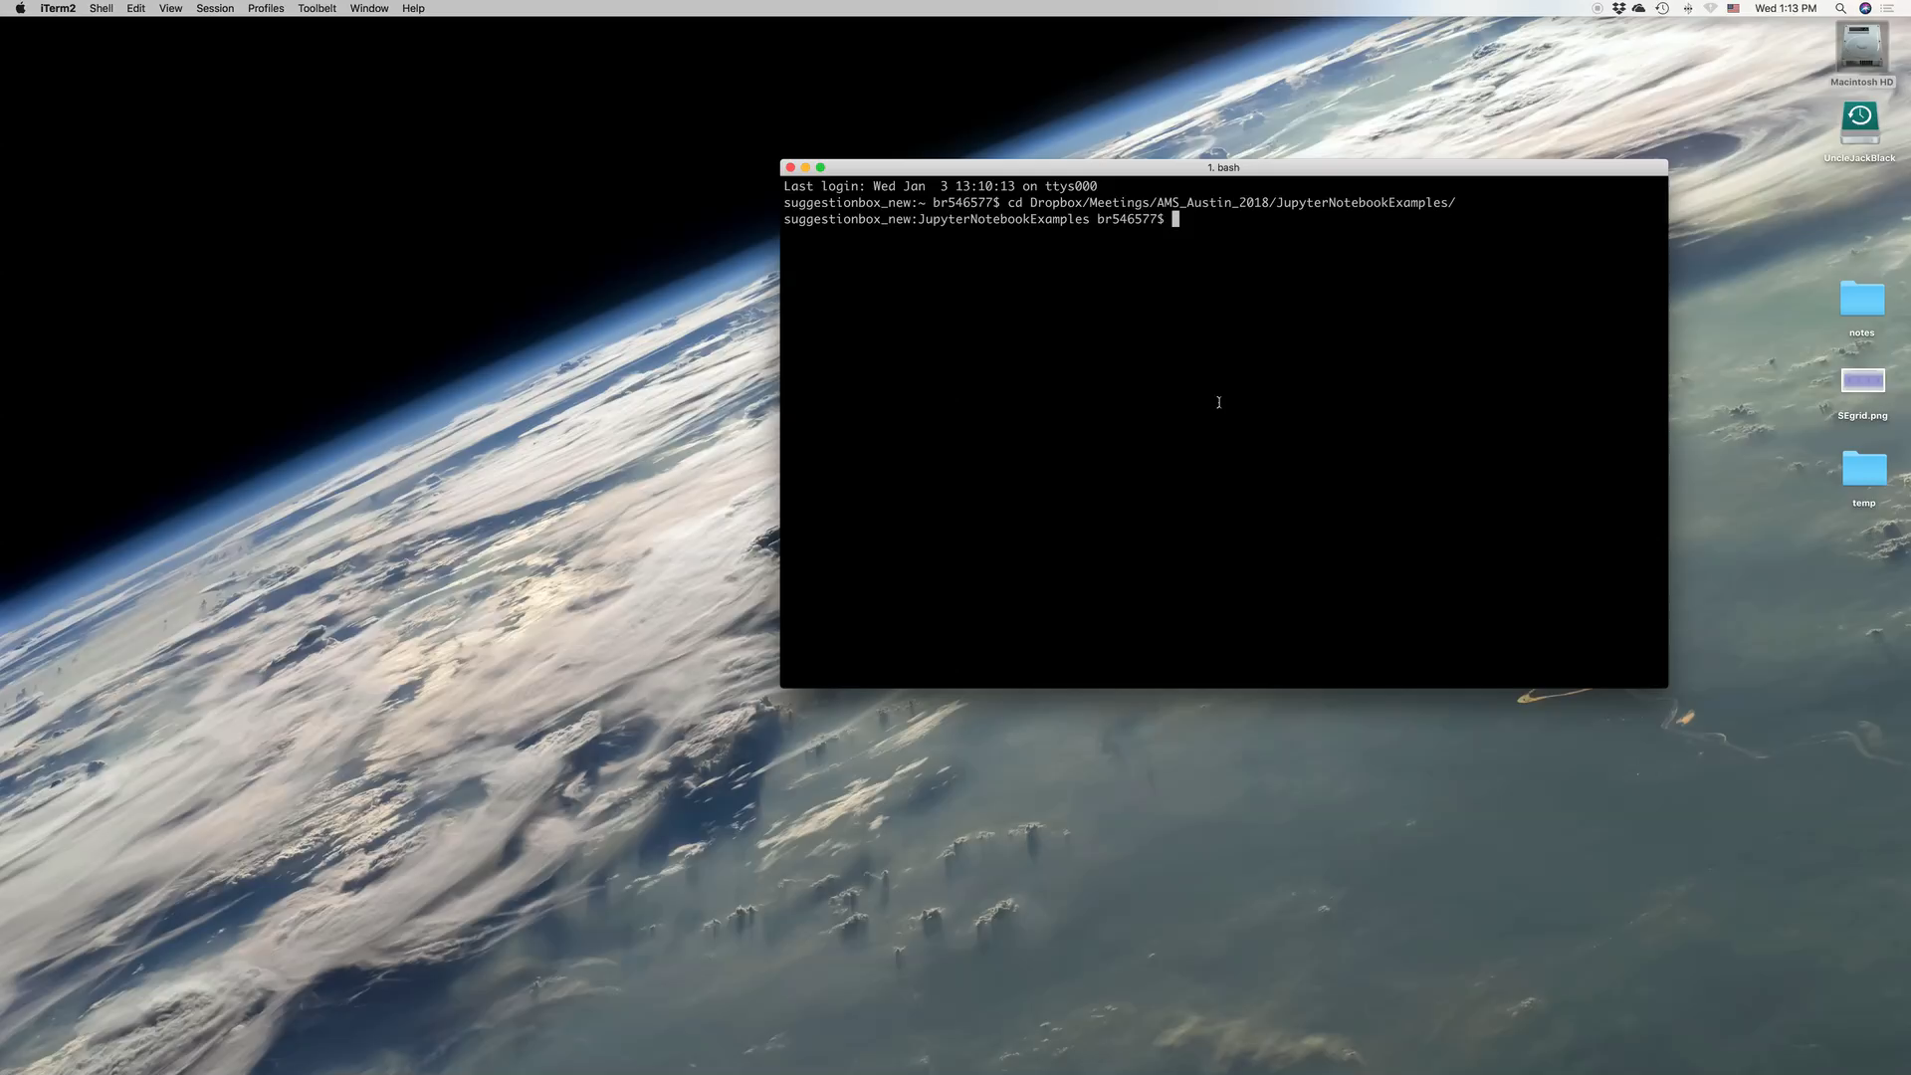
Creating a simple notebook (text, equations, code and graphics)

Slide 8
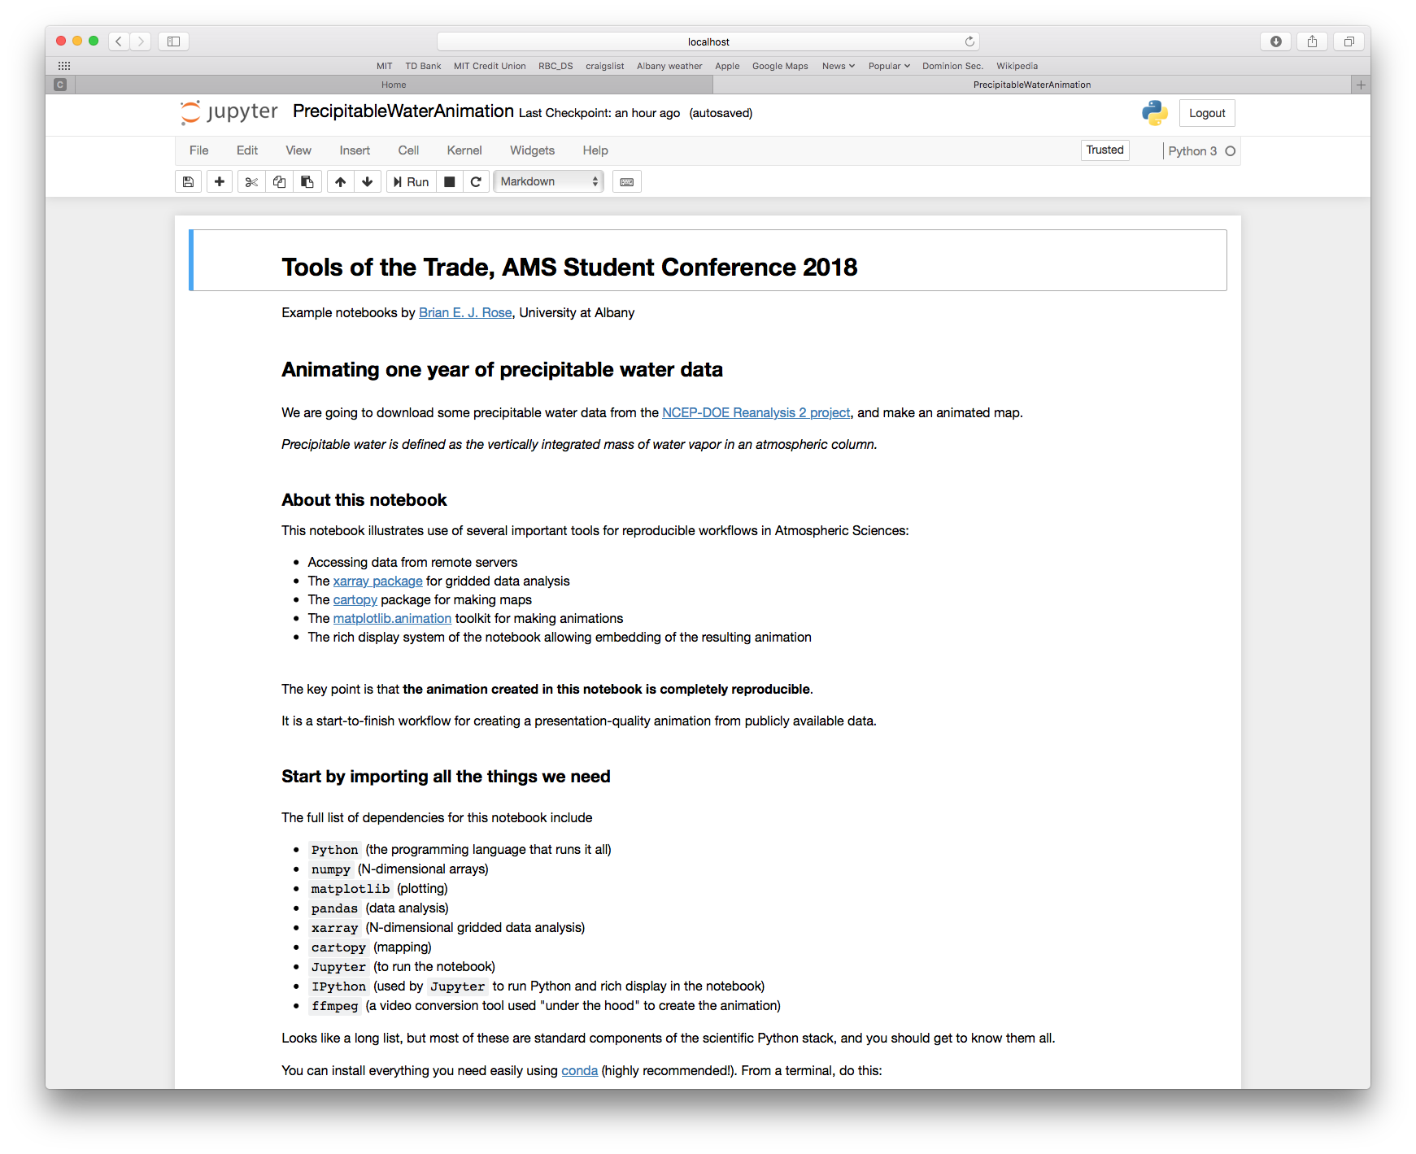
A more interesting example
Using the notebook for interactive data analysis, plotting and animation
Screenshots from the notebook PrecipitableWaterAnimation.ipynb

Slide 9
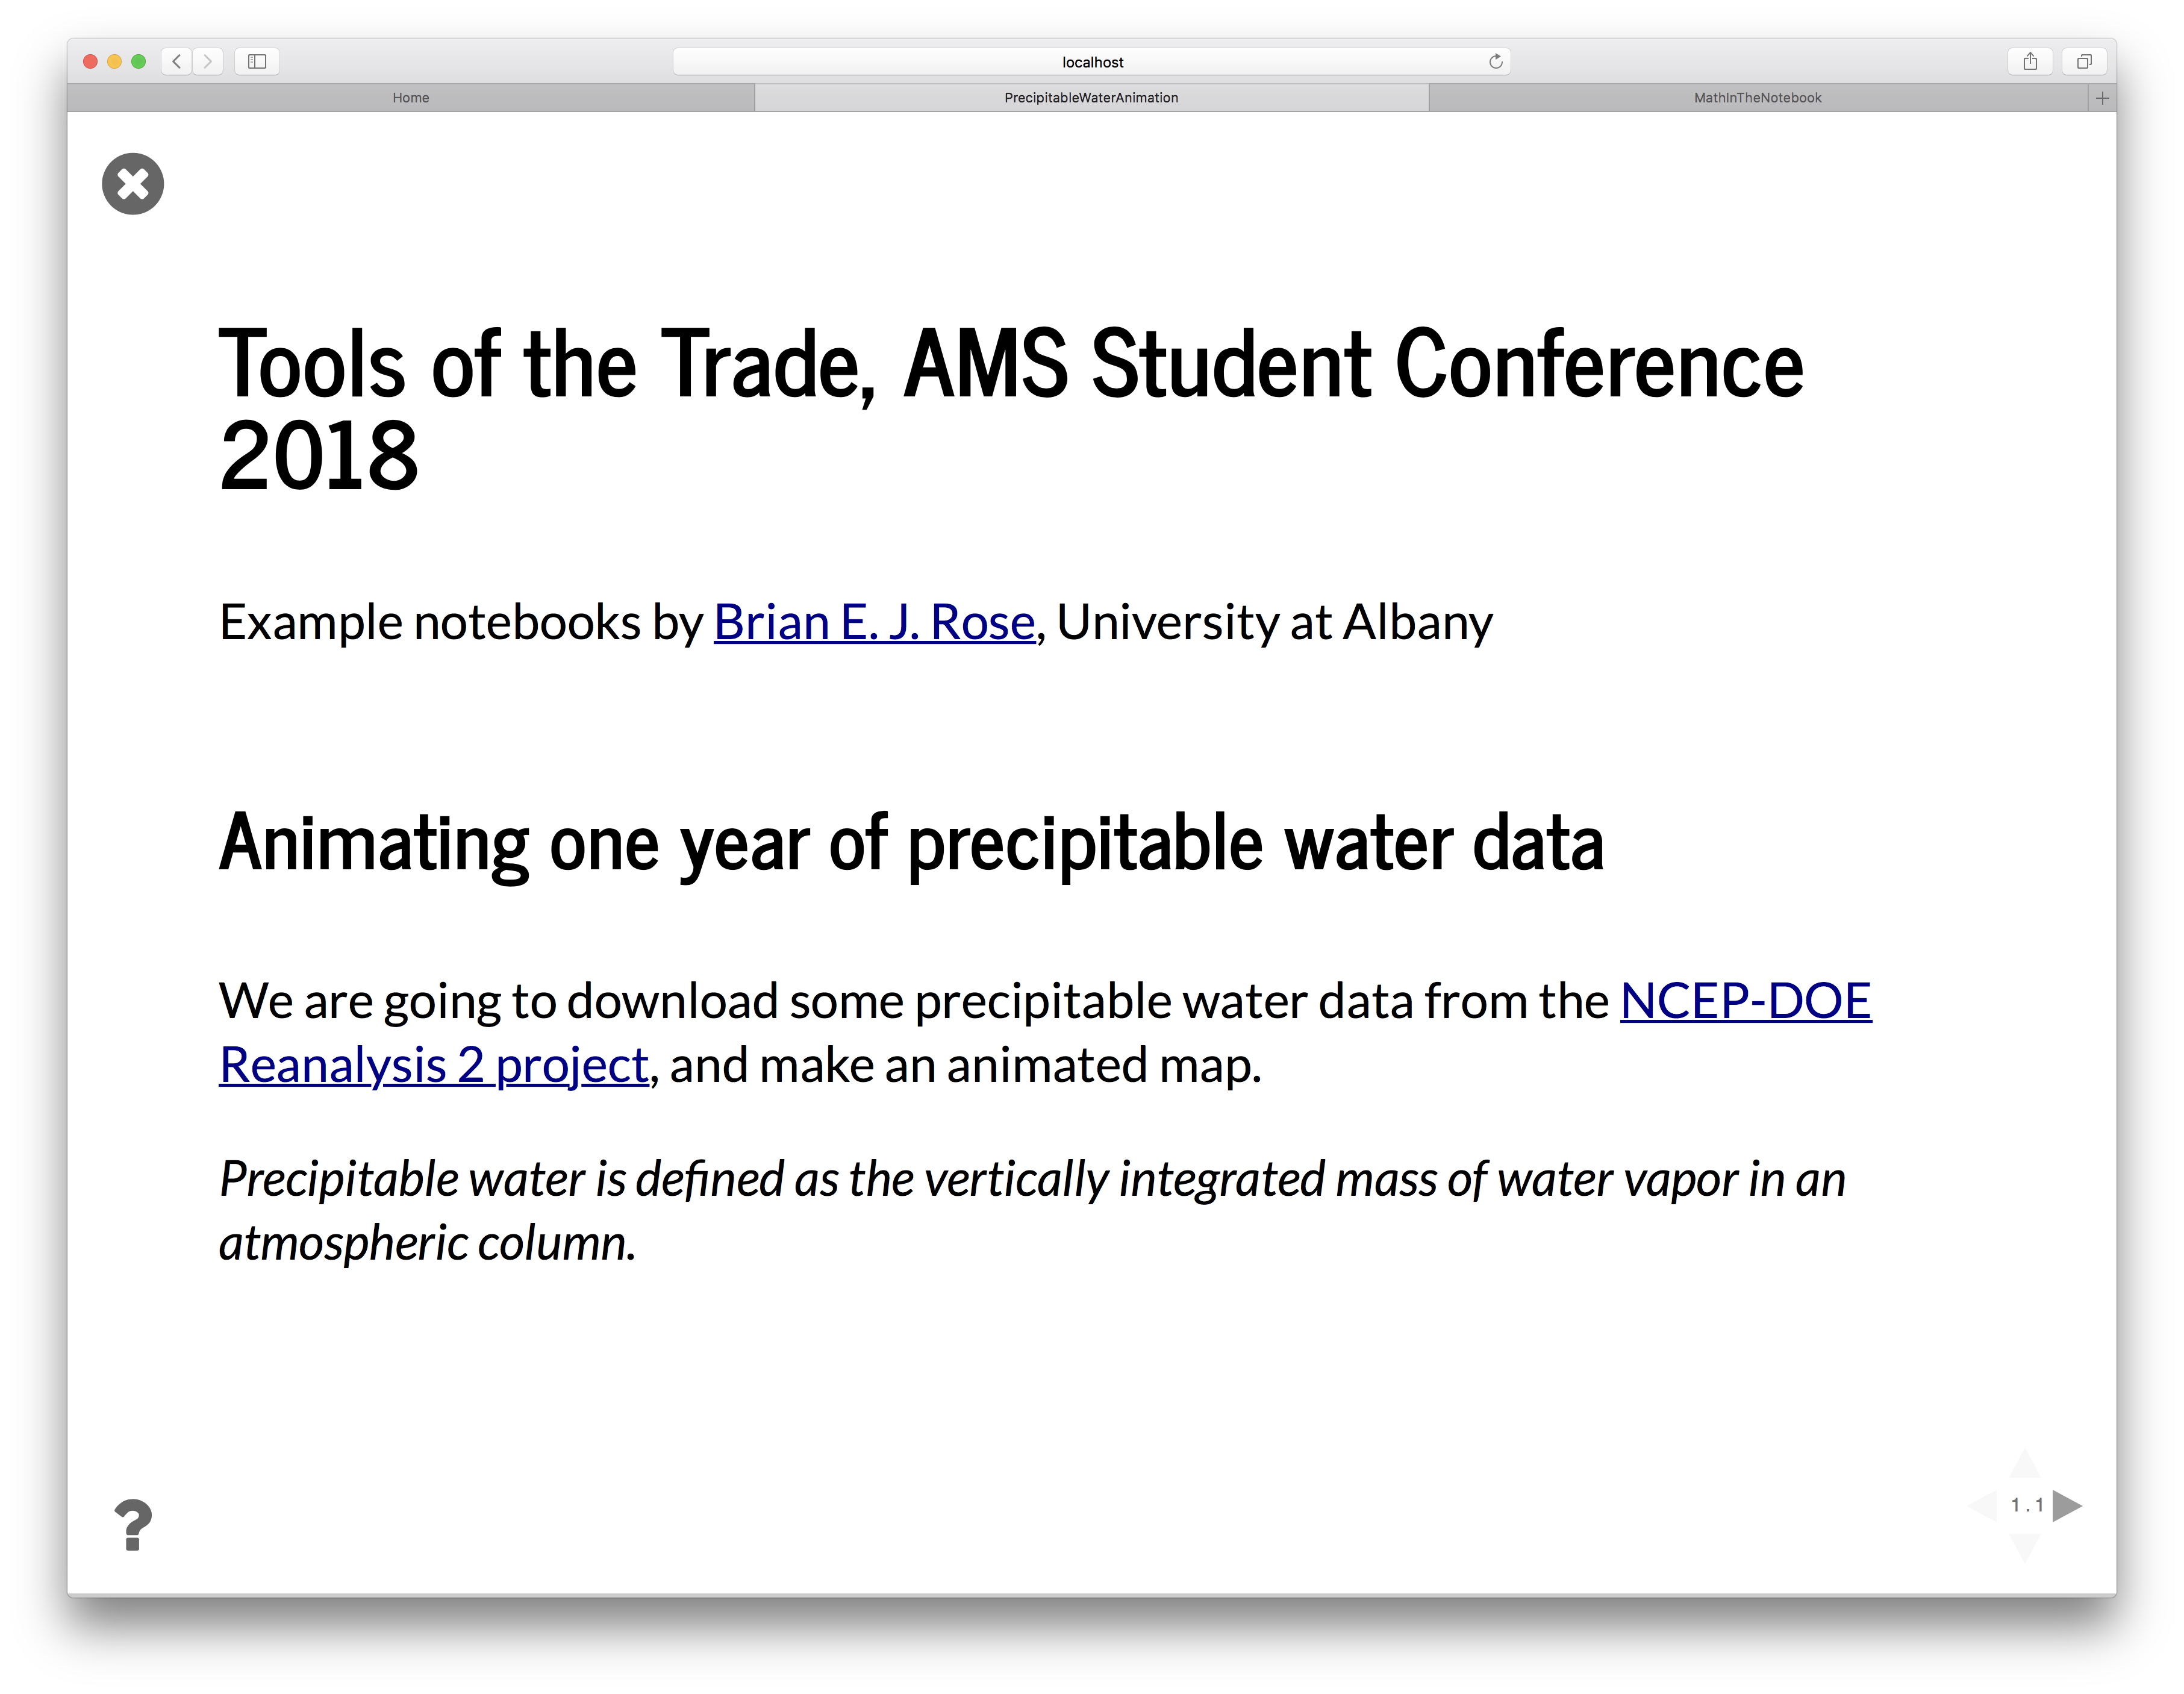

Slide 10
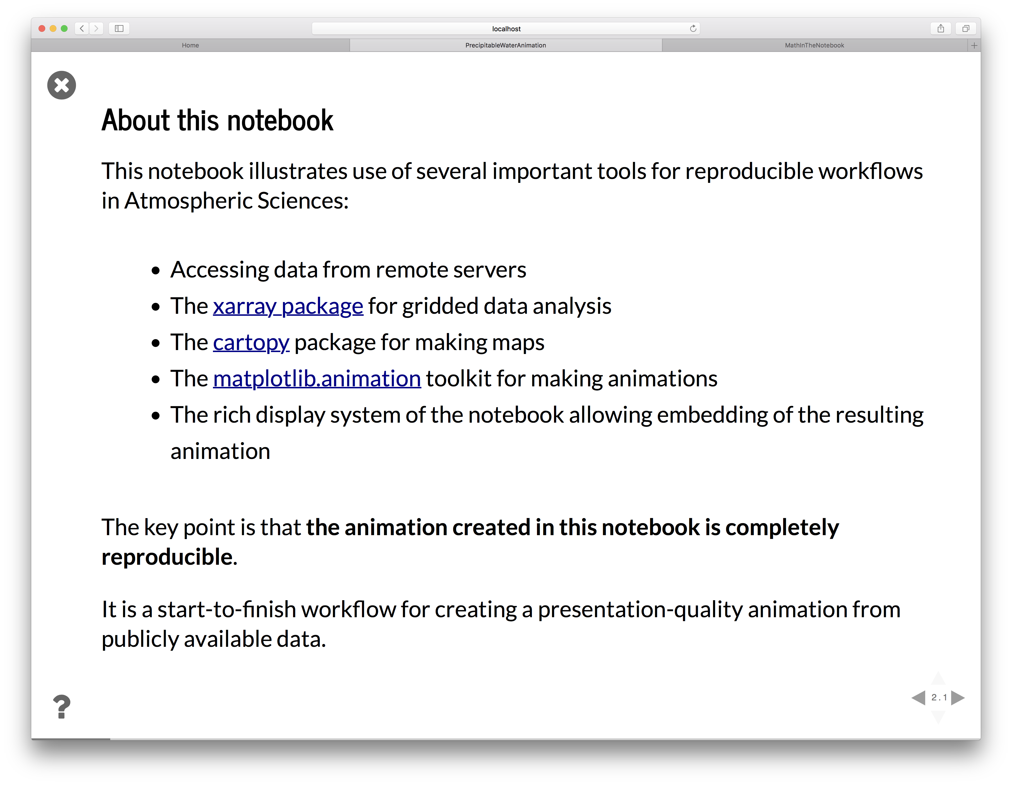

Slide 11
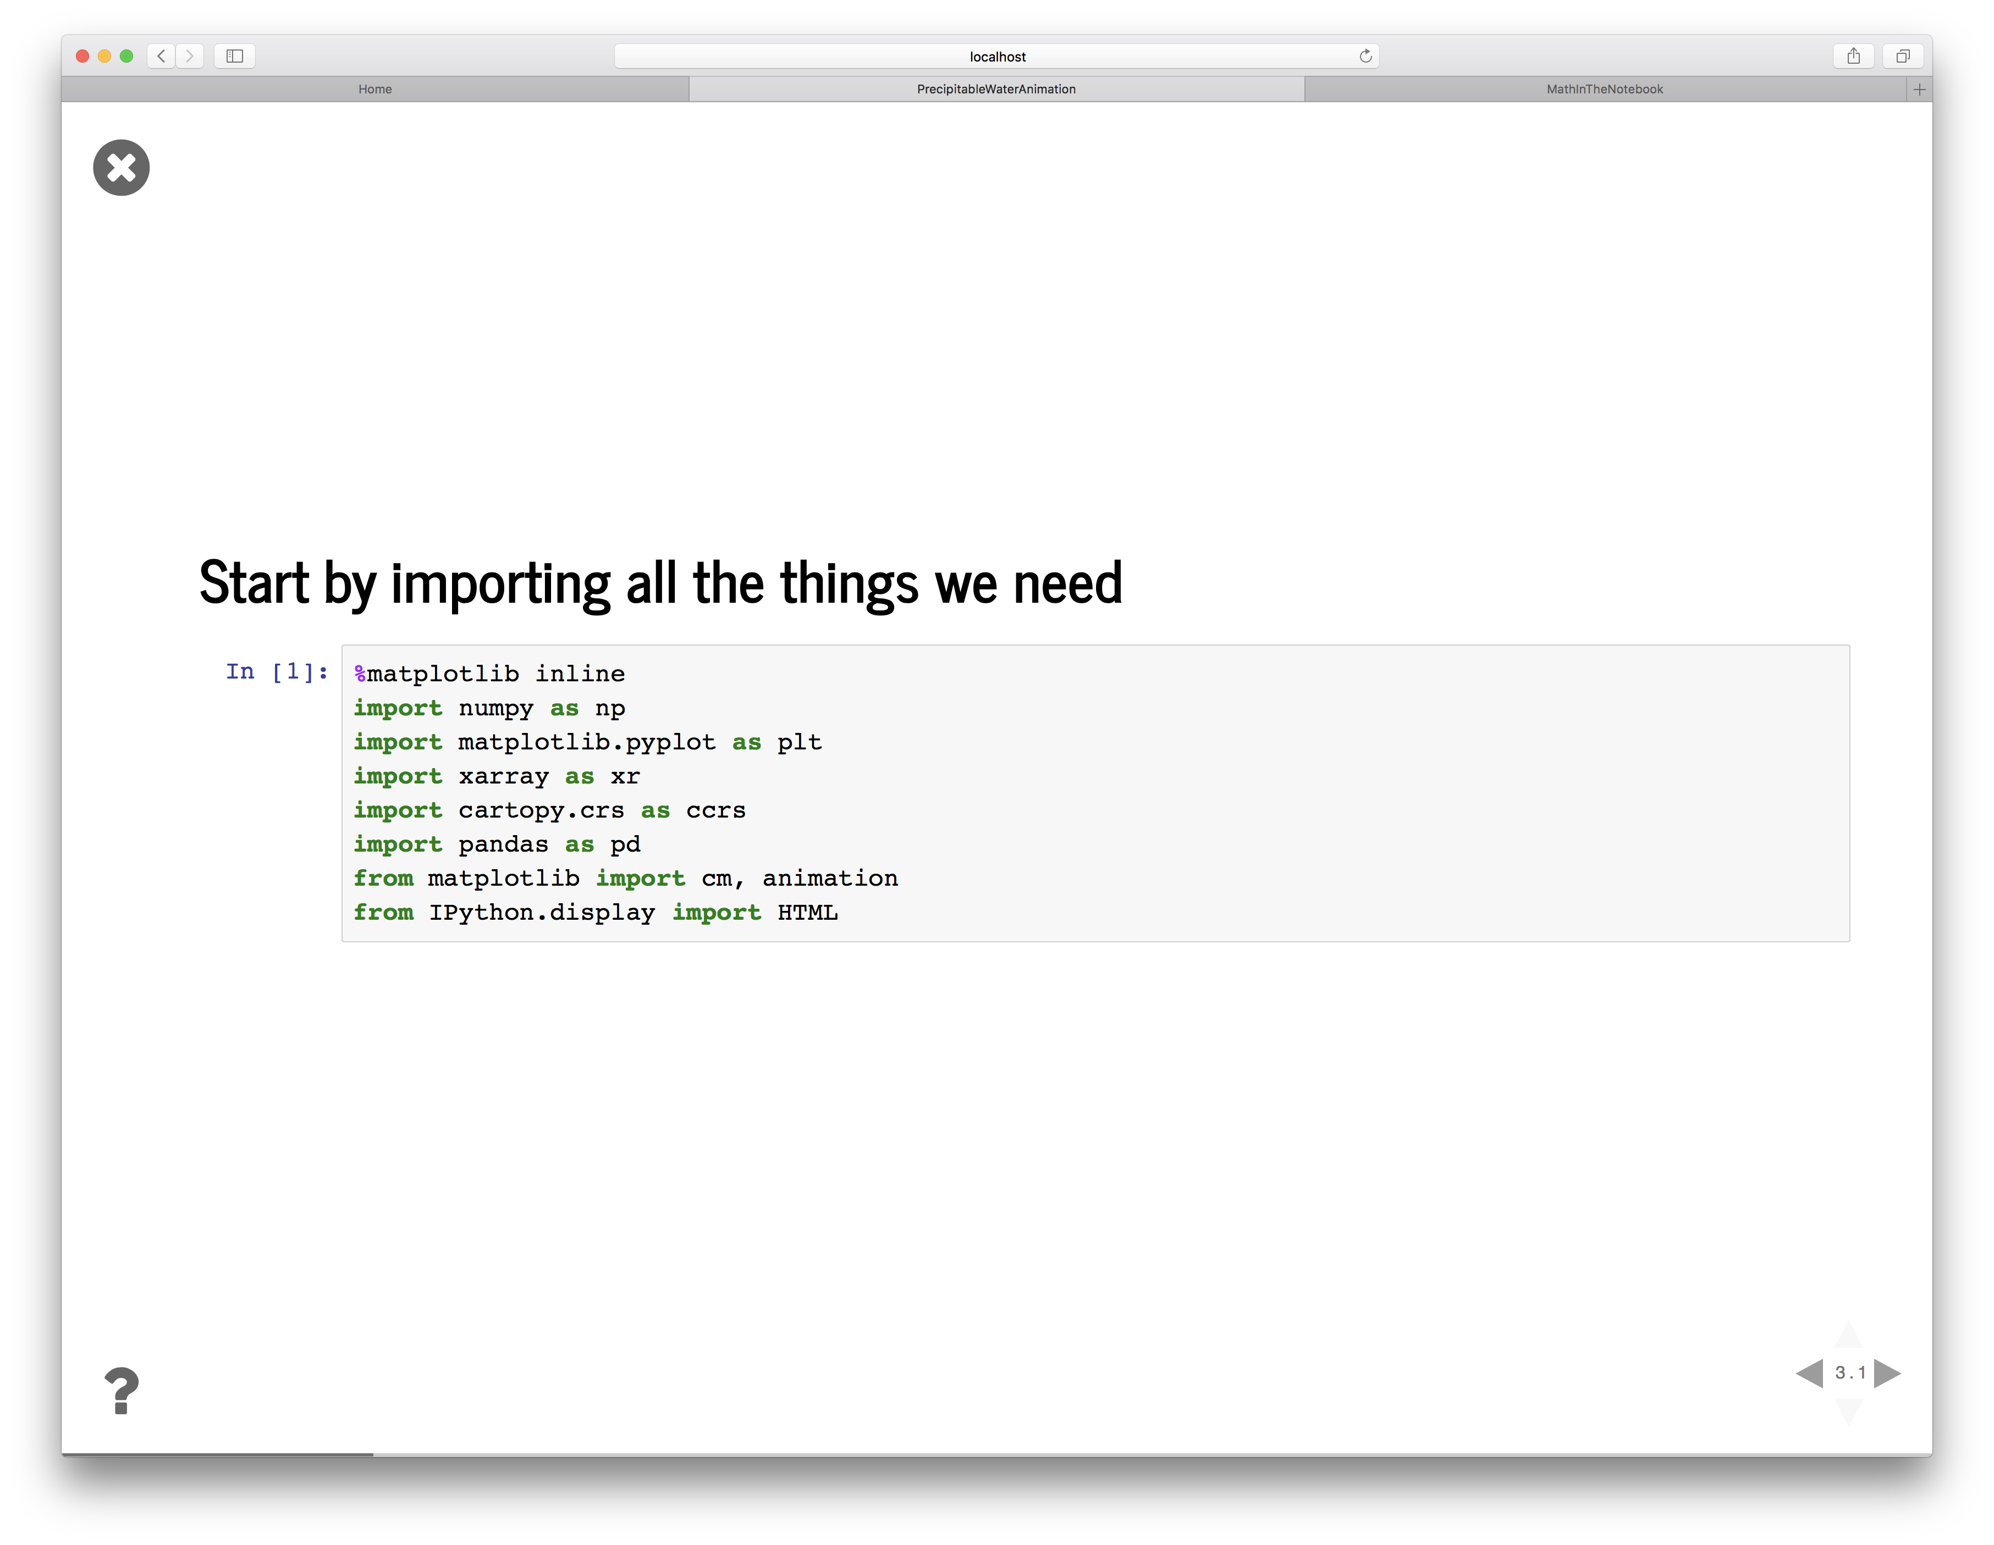

Slide 12
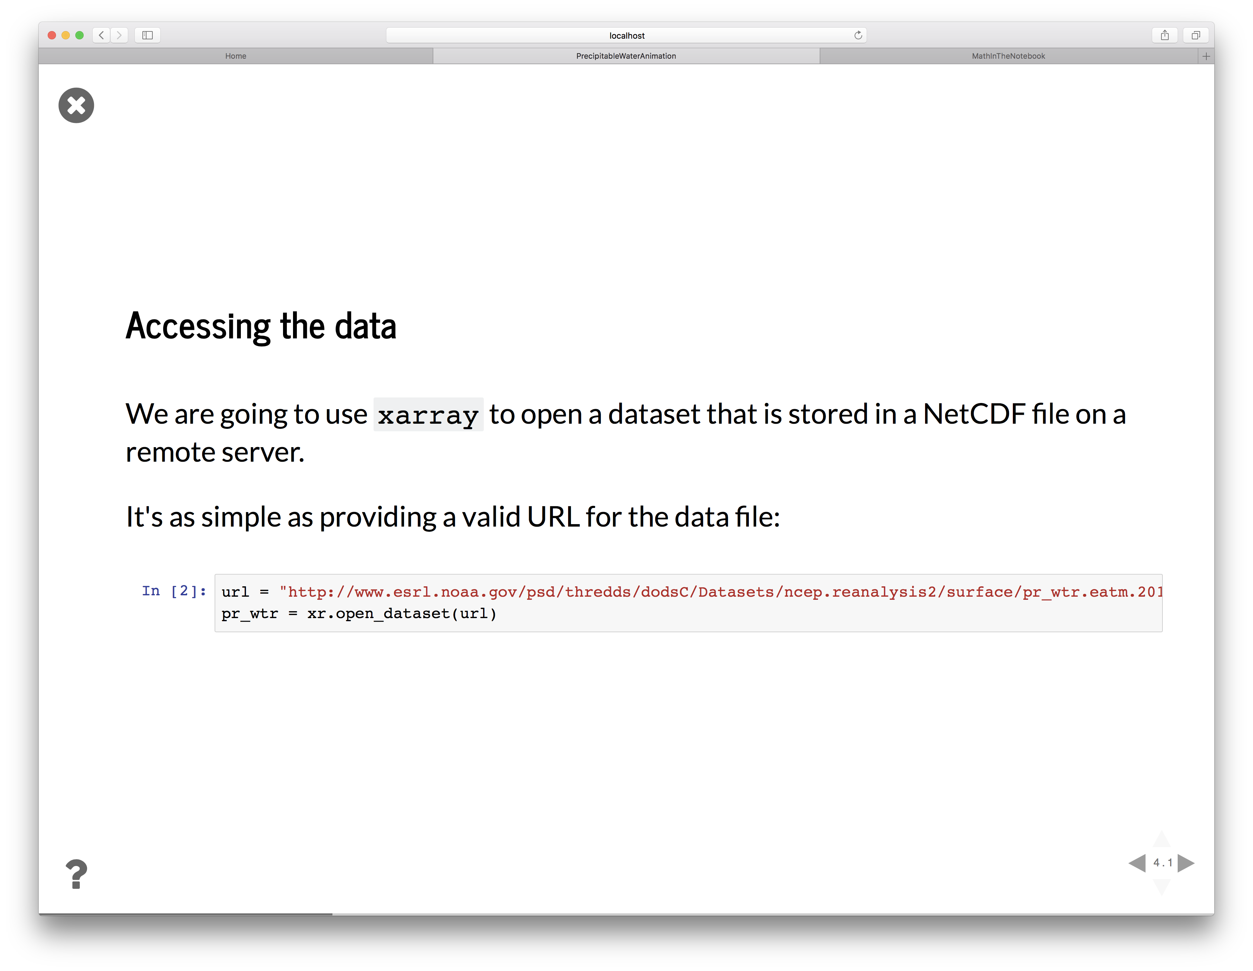

Slide 13
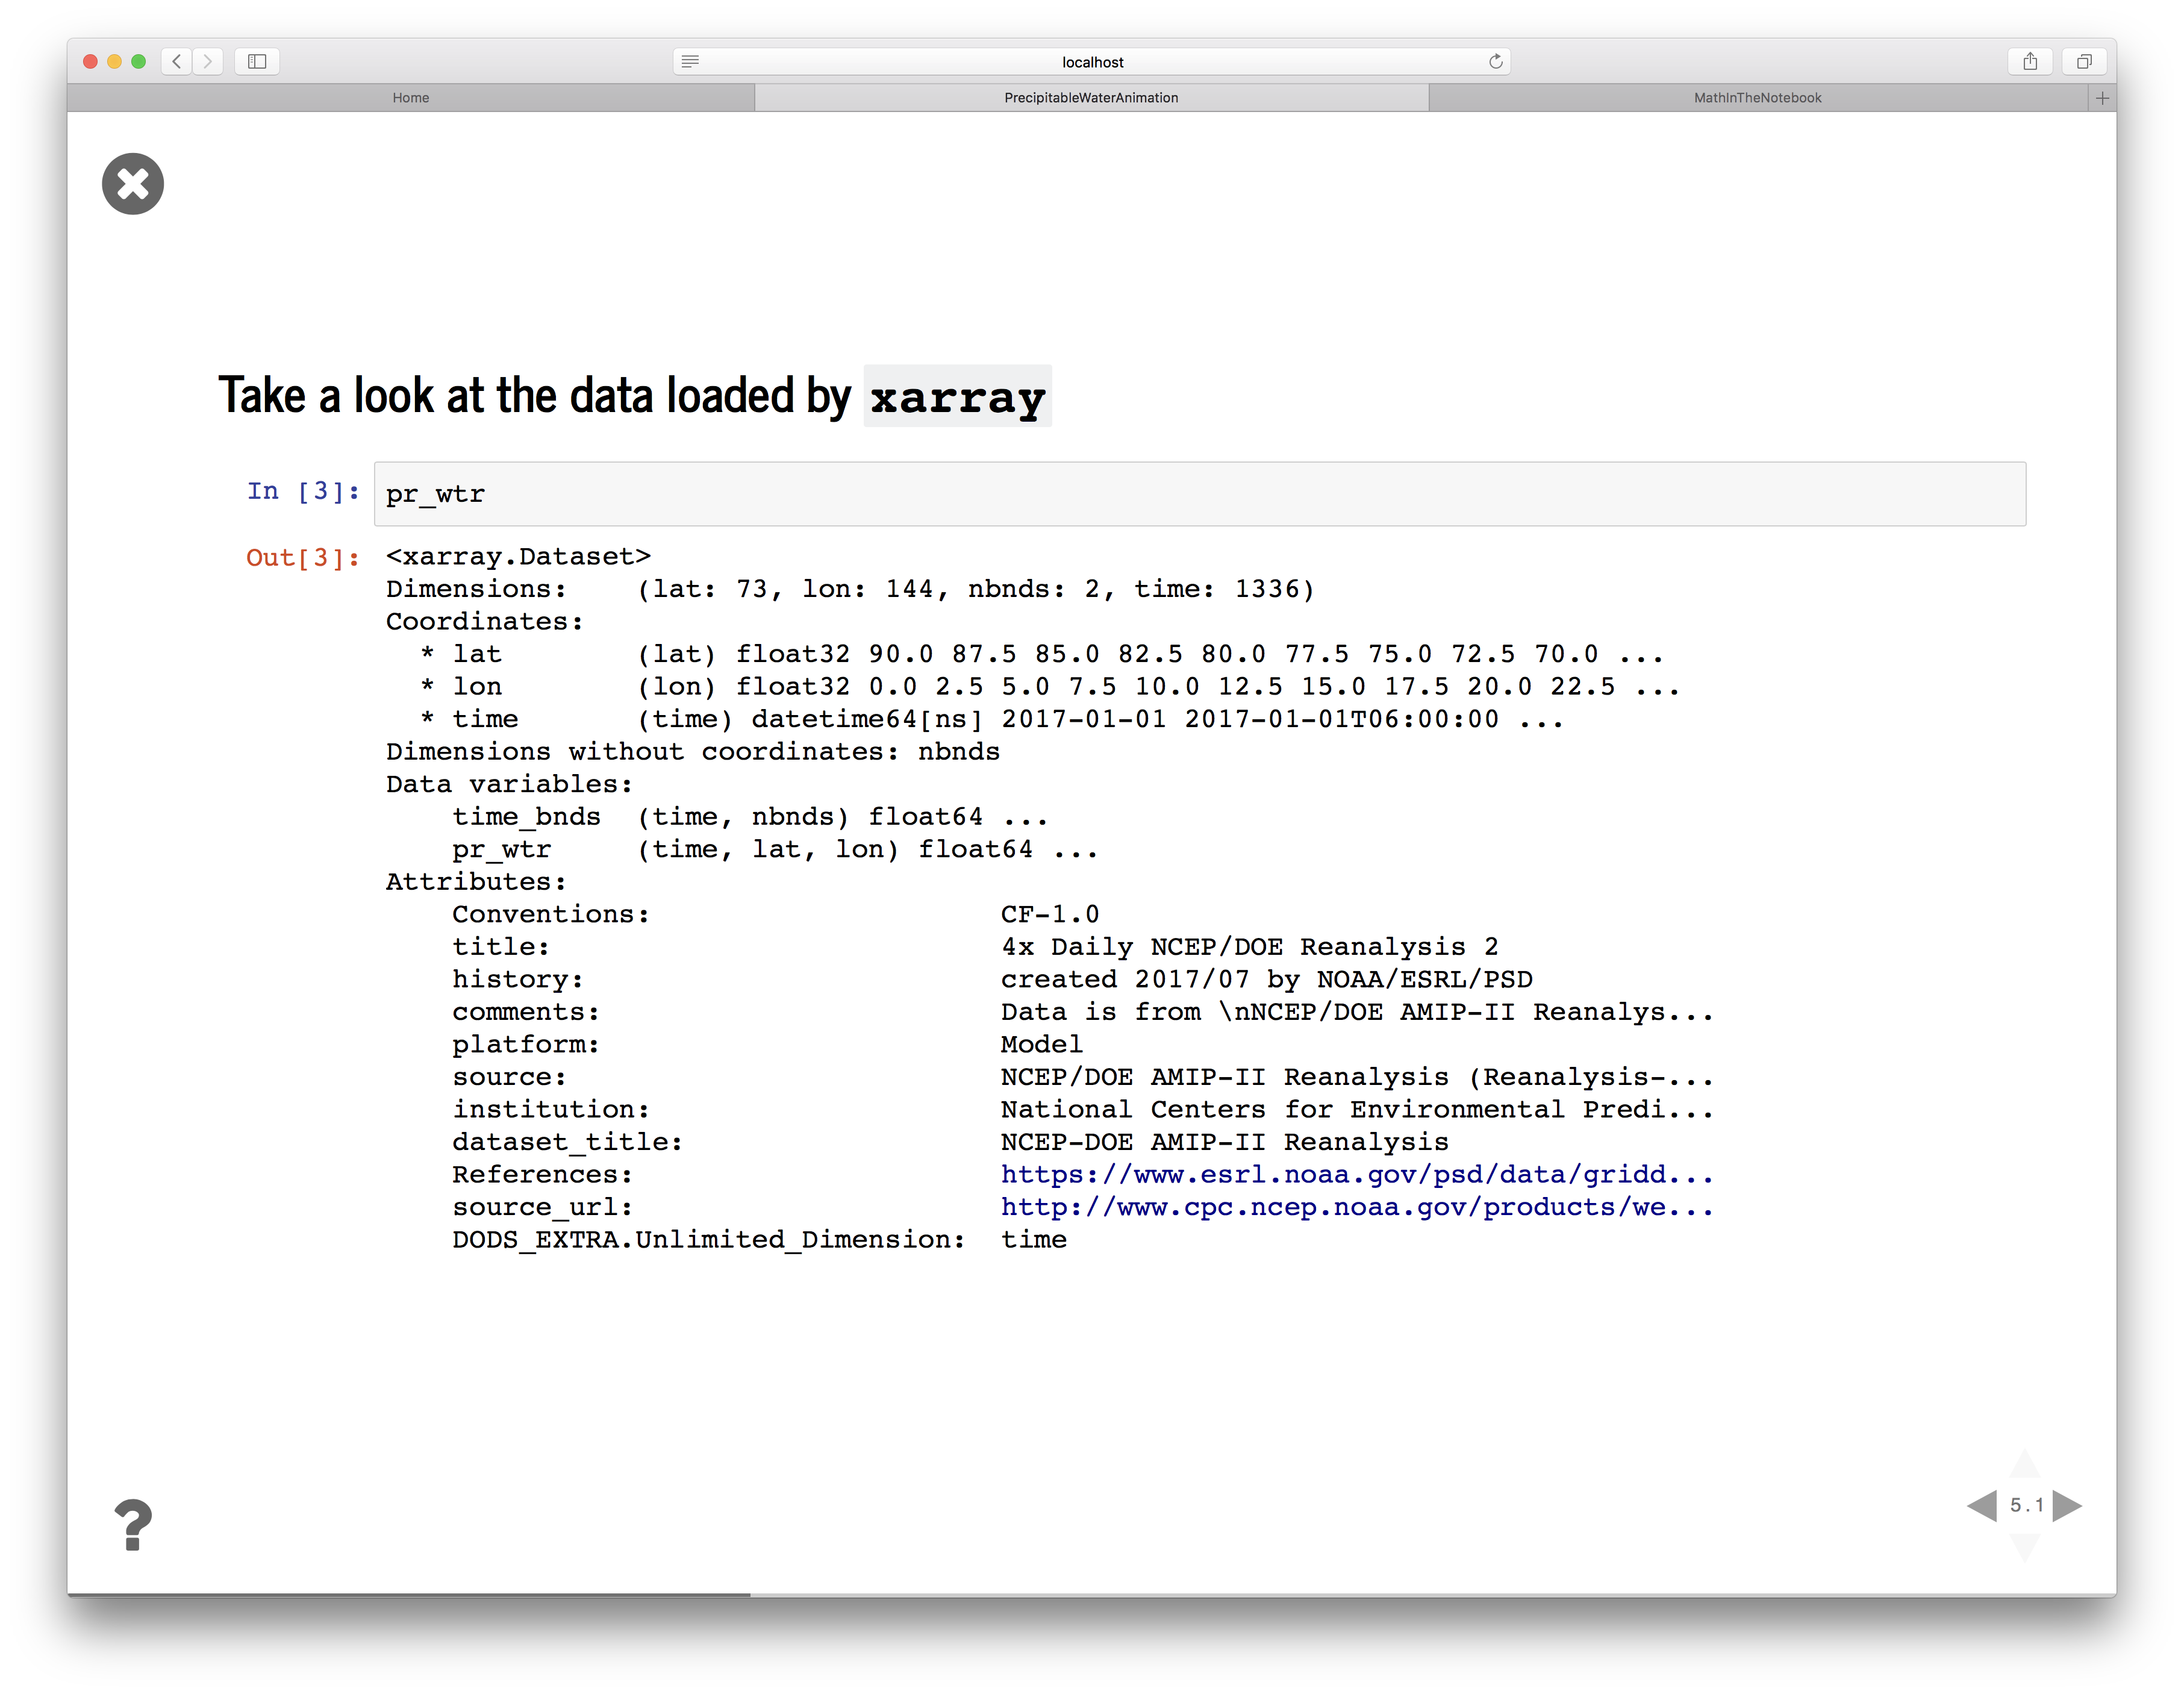

Slide 14
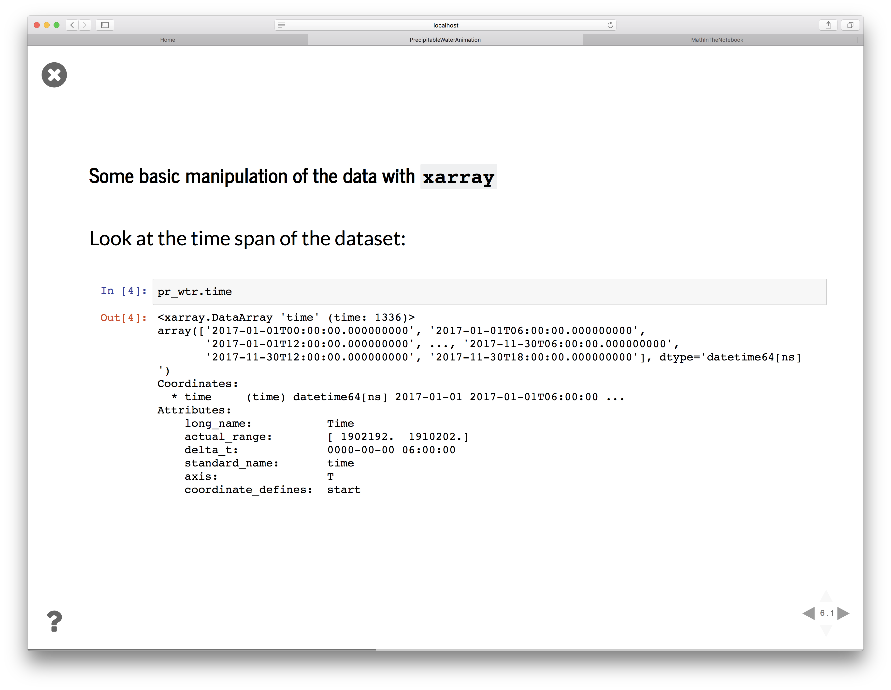

Slide 15
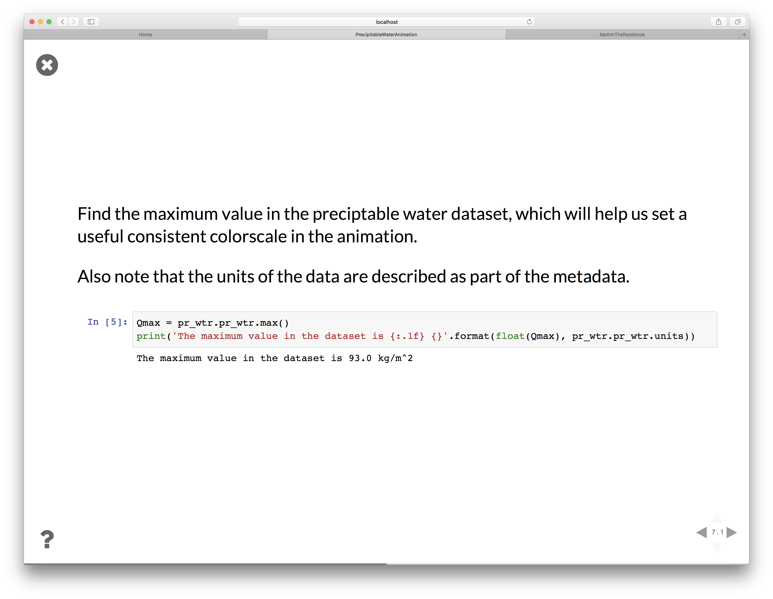

Slide 16
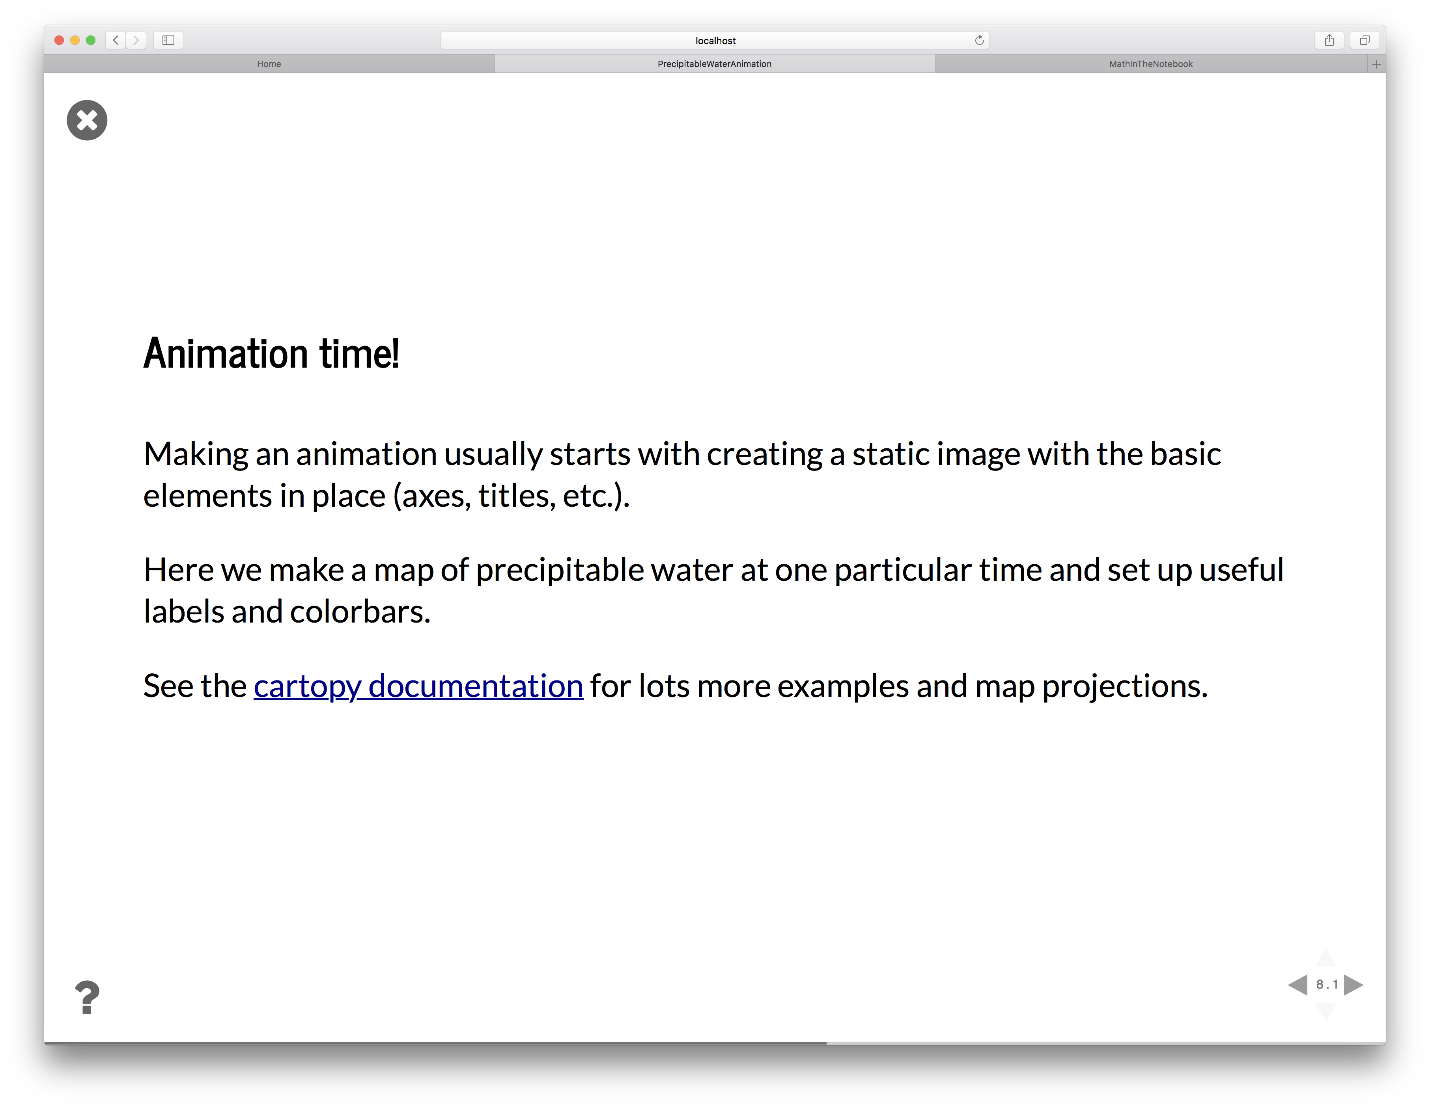

Slide 17
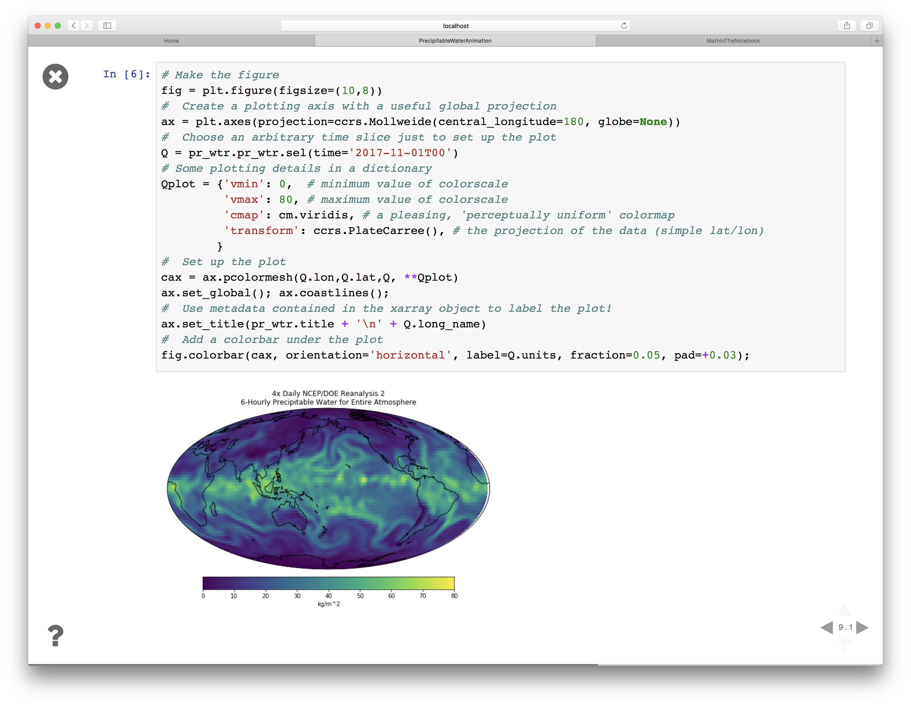

Slide 18
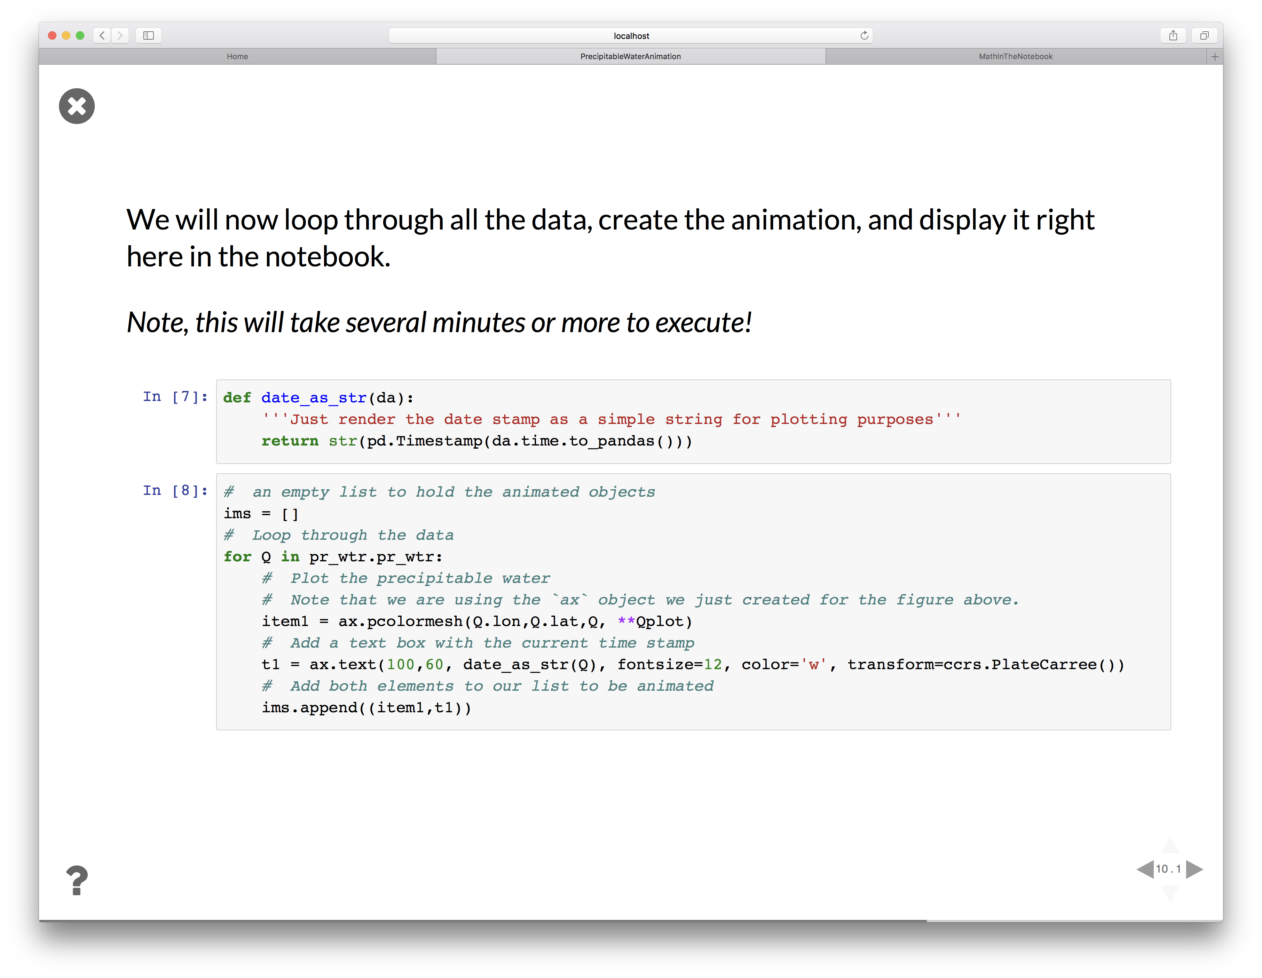

Slide 19
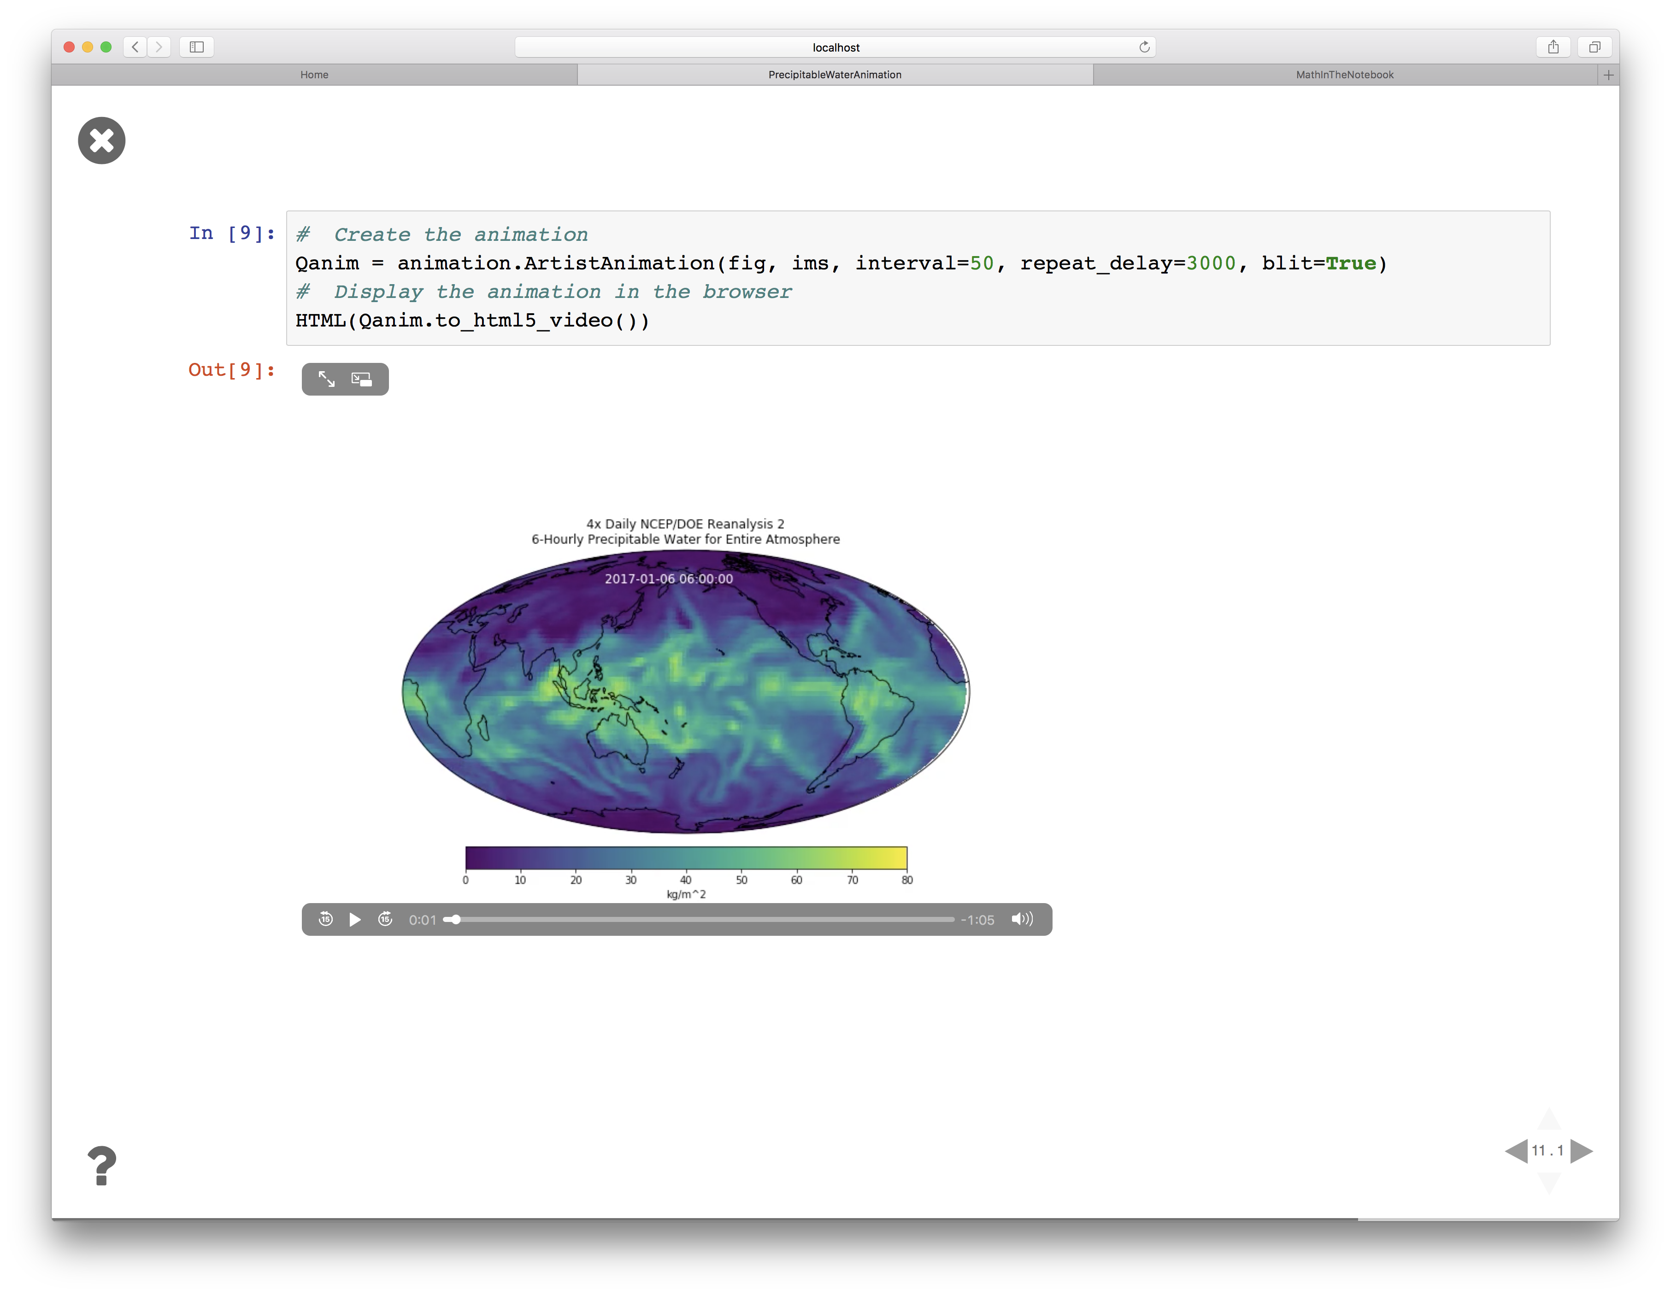

Slide 20
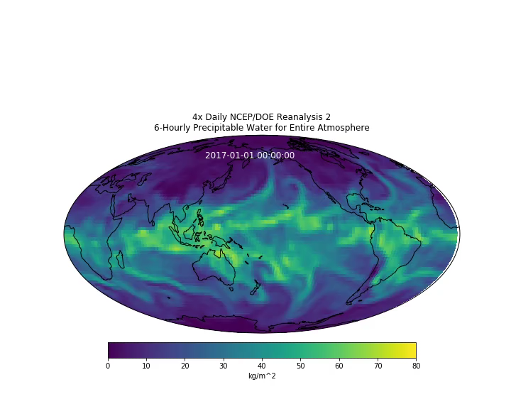

Slide 21
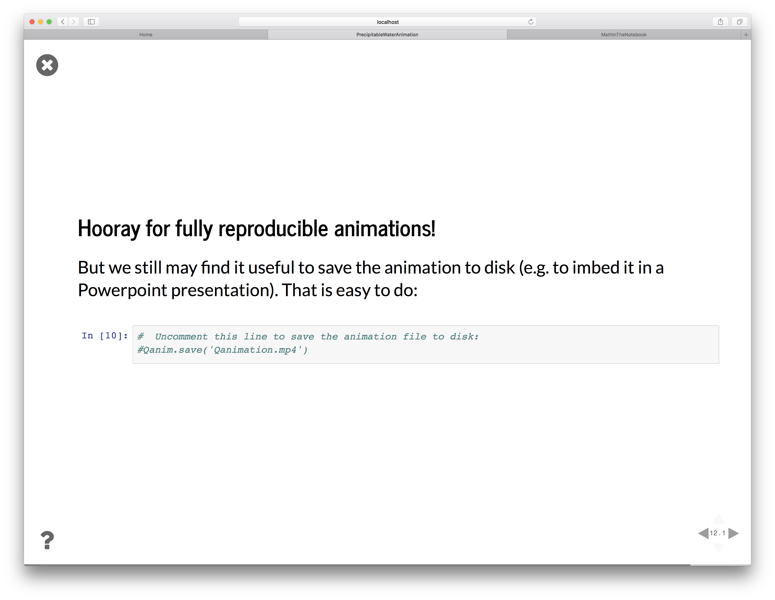

Slide 22
Get started on your own laptop
Try out the example notebooks in the cloud!
https://mybinder.org/v2/gh/brian-rose/ToolsOfTheTrade2018_JupyterNotebooks/master
Install Anaconda Python (it’s free for Mac, Linux and Windows!)
https://www.anaconda.com/distribution/
Download my example notebooks:
https://github.com/brian-rose/ToolsOfTheTrade2018_JupyterNotebooks
To install everything else you need for these examples:
conda install xarray cartopy ffmpeg
Type jupyter notebook in your favorite terminal
The notebooks are interactive. Play!
Going deeper
A collection of lecture notes on Climate Modeling in Jupyter notebooks:
https://github.com/brian-rose/ClimateModeling_courseware

